Slide 1

CIS-4951
With Dr. Bruce Maxim
Sky Socket
Project Plan and Risk Management Presentation
Demetrius Johnson
Olivia Pellegrini
Ryan Sauer
Jonathan Schall

Slide 2

Project Management Plan
An image recognition algorithm running on the drone for detecting a predefined object
A manual/automatic control mechanism for the car
A manual/automatic control mechanism for the drone
A multiple communication protocols for use between the drone and car
An ascii based log system to store data points about the drones battery life, bandwidth, and latency.
A way to extract drone data logs from the raspberry pi
A way to extract car data logs from the raspberry pi
Notes:
meech

Slide 3
Major Software Functions
Drone-Car communication network interface
Vision data processing in OpenCV Python
Drone autonomous flight programming
Car autonomous driving programming
Car and Drone data metric collection and synthesis from sensory information
Notes:
meech

Slide 4
Performance/Behavior Issues
Communication Optimization
Drone Movement
Performance/Behavior Issues
Time
Access
Notes:
meech

Slide 5
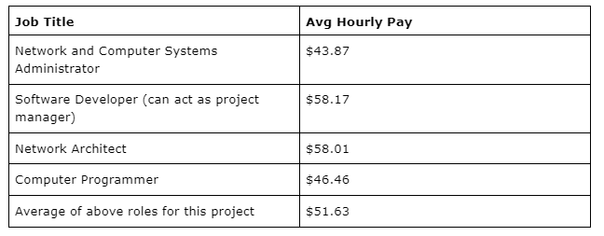
Project Estimates
We obtained the following data from the Bureau of Labor Statistics who’s data is from May 2021: https://www.bls.gov/oes/current/oes_stru.htm
Notes:
meech

Slide 6
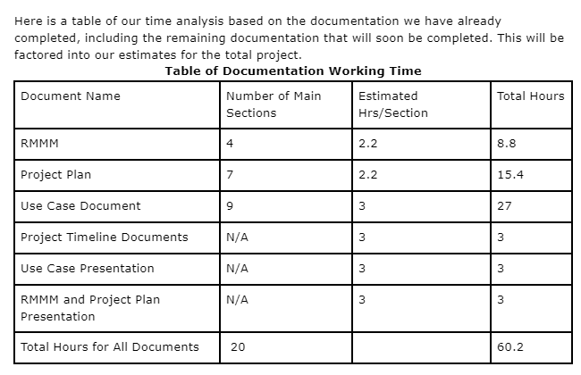
Project Estimates
We obtained the following data from the Bureau of Labor Statistics who’s data is from May 2021: https://www.bls.gov/oes/current/oes_stru.htm
Notes:
meech

Slide 7
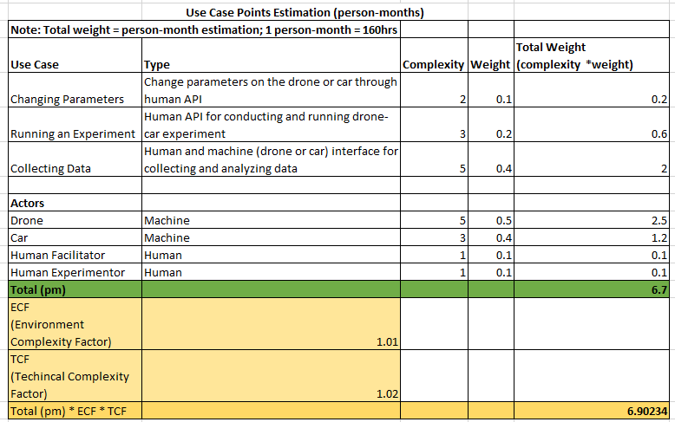
Estimation Techniques: Use Case Points
Notes:
meech

Slide 8
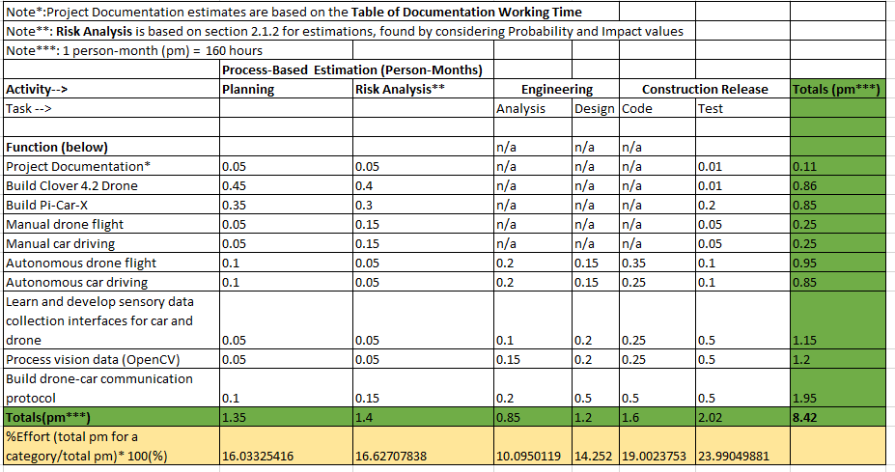
Estimation Techniques: Process-Based
Notes:
meech

Slide 9
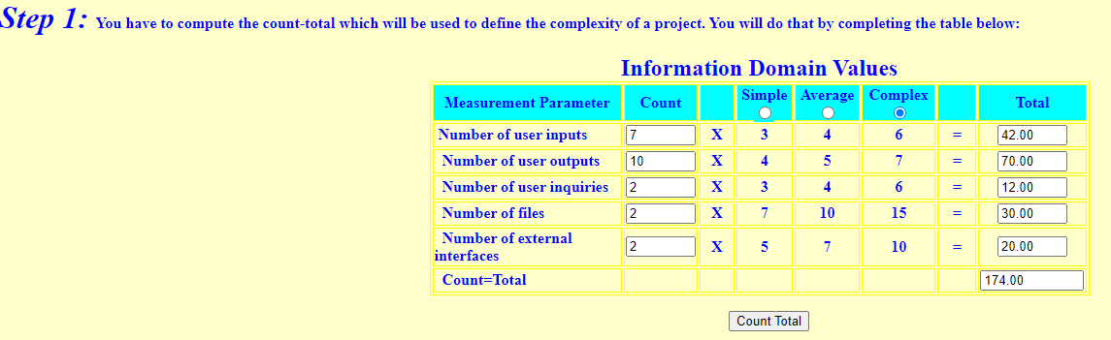
Estimation Techniques: COCOMO FP
http://groups.umd.umich.edu/cis/course.des/cis525/js/f00/gamel/cocomo.html
Notes:
meech

Slide 10
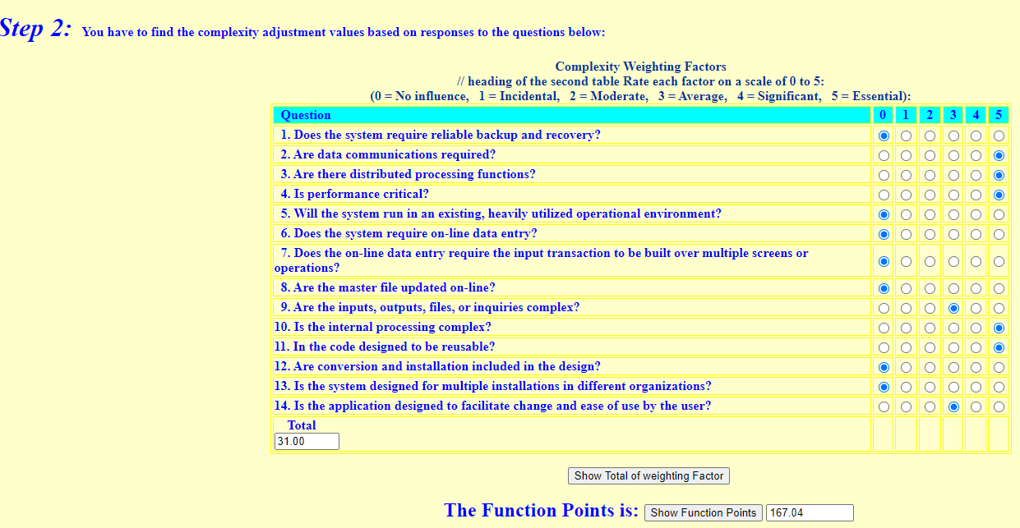
Estimation Techniques: COCOMO FP
Notes:
meech

Slide 11
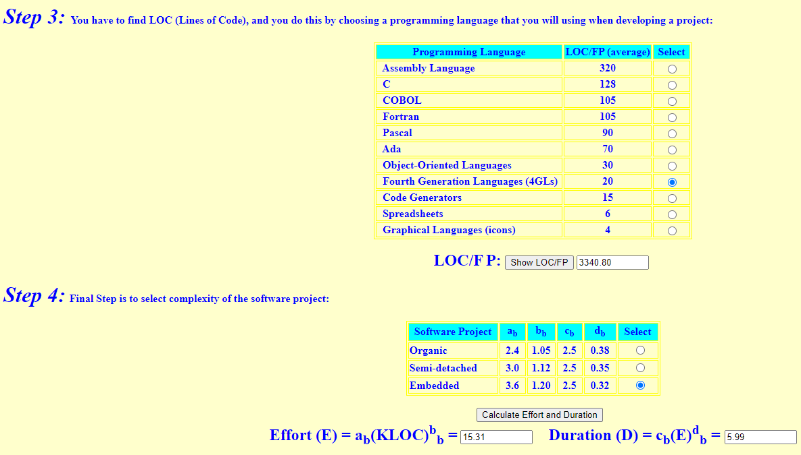
Estimation Techniques: COCOMO FP
Notes:
meech

Slide 12
Reconciled Estimates
As a summary of the results of our estimation from the techniques:
Use Case Points person-month estimation: 6.9
Process-Based person-month estimation: 8.42
COCOMO FP estimation: 5.99
Average: 7.10 person-months
Based on the hourly average hourly pay of the technical roles necessary for this project, then monetary cost for the project is estimated to be
7.10pm * 160hr/pm * $51.63 = $58,651 TOTAL PROJECT COST
Special Note: we estimate that on average among 4 team members, we can each work on average 8hrs per week, which equates to (0.2pm = 32hrs per month).
4members * 0.2pm/member * 7months for senior design = 5.6pm that our team estimates we can allocate from our time.
Thus, based on this estimate, we would need to work above average at some points in the project, particularly during the summer (senior design 2).
Notes:
meech
As a summary of the results of our estimation from the techniques:
Use Case Points person-month estimation: 6.9
Process-Based person-month estimation: 8.42
COCOMO FP estimation: 5.99
Average: 7.10 person-months
Based on the hourly average hourly pay of the technical roles necessary for this project, then monetary cost for the project is estimated to be
7.10pm * 160hr/pm * $51.63 = $58,651 TOTAL PROJECT COST
Special Note, we estimate that on average among 4 team members, we can each work on average 8hrs per week, which equates to (0.2pm = 32hrs per month).
4members * 0.2pm/member * 7months for senior design = 5.6pm that our team estimates we can allocate from our time.
Thus, based on this estimate, we would need to work above average at some points in the project, particularly during the summer (senior design 2).
Senior design 1 and 2 combined leave about 7 months to complete the project. Our estimation of 7.10pm means we definitely face the possibility of shortcomings in the project including failing to finish it, including considering that we estimate we can only contribute 5.6pm as a team since we as students do not have a full 40 hours

Slide 13
Project Resources: Hardware and Software
Raspberry Pi model 4B
Raspberry Pi Ai Car Kit (PiCar-X) for Intermediate
Python Programming Language
OpenCV-Python Library
Raspbian OS builds with Linux Kernel
Q Ground Control
Clover Drone Simulation virtual machine (VM) image
Drone Simulation Environment (Using Gazebo software)
Etcher - Flashing Software
Dr. Zheng Song Research Lab
Notes:
meech
As a summary of the results of our estimation from the techniques:
Use Case Points person-month estimation: 6.9
Process-Based person-month estimation: 8.42
COCOMO FP estimation: 5.99
Average: 7.10 person-months
Based on the hourly average hourly pay of the technical roles necessary for this project, then monetary cost for the project is estimated to be
7.10pm * 160hr/pm * $51.63 = $58,651 TOTAL PROJECT COST
Special Note, we estimate that on average among 4 team members, we can each work on average 8hrs per week, which equates to (0.2pm = 32hrs per month).
4members * 0.2pm/member * 7months for senior design = 5.6pm that our team estimates we can allocate from our time.
Thus, based on this estimate, we would need to work above average at some points in the project, particularly during the summer (senior design 2).
Senior design 1 and 2 combined leave about 7 months to complete the project. Our estimation of 7.10pm means we definitely face the possibility of shortcomings in the project including failing to finish it, including considering that we estimate we can only contribute 5.6pm as a team since we as students do not have a full 40 hours

Slide 14
Risk Management
We want our project to be free of any issues that would significantly delay the project, as well as any issues that would make our project unusable. We do not expect to stop all delays and imperfections and believe that the project can still be successful with some minor flaws. Therefore, our risk management plan focuses on only issues that are significant enough to cause the project to fail.
Everyone working on the project is responsible for managing the project’s risks.
Each project member should stay on task and ensure the group is
The client can manage risks by making his requirements clear early on and making sure the team is meeting his expectations throughout the project
Notes:
meech

Slide 15
Project Risks
Equipment Risks
Drone/Car Failure
Employee Risk
Slacking off
Quality Risk
model isn’t up to client standards
Customer Risk
Losing interest
Notes:
meech

Slide 16
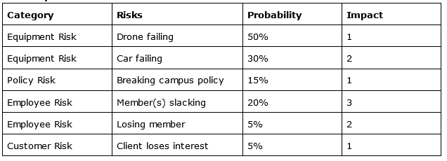
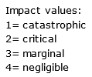
Probability and Impact for Risk M
Notes:
meech

Slide 17
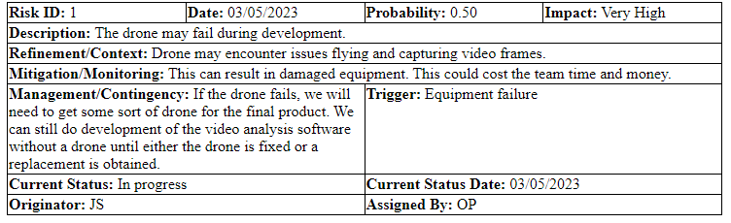
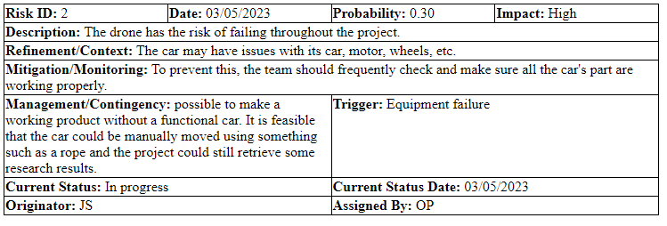
3.3 Overview of Risk Mitigation, Monitoring, Management
Notes:
olivia

Slide 18
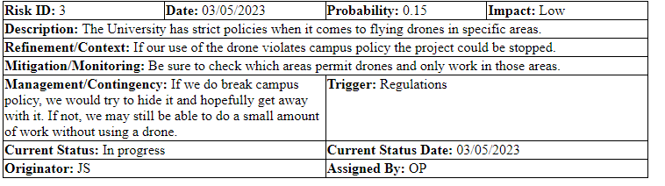
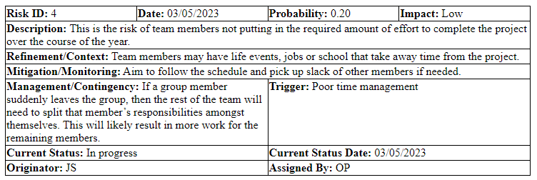
3.3 Overview of Risk Mitigation, Monitoring, Management
Notes:
olivia

Slide 19
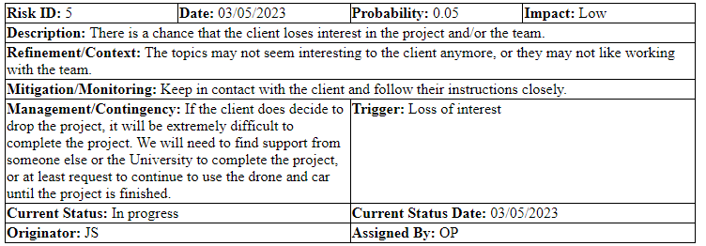
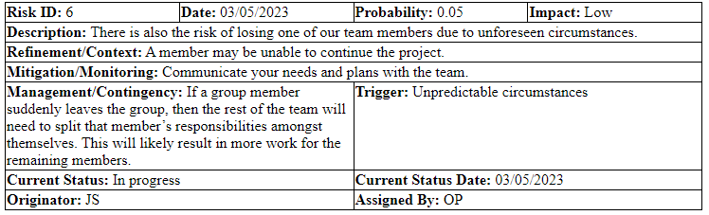
3.3 Overview of Risk Mitigation, Monitoring, Management
Notes:
js

Slide 20
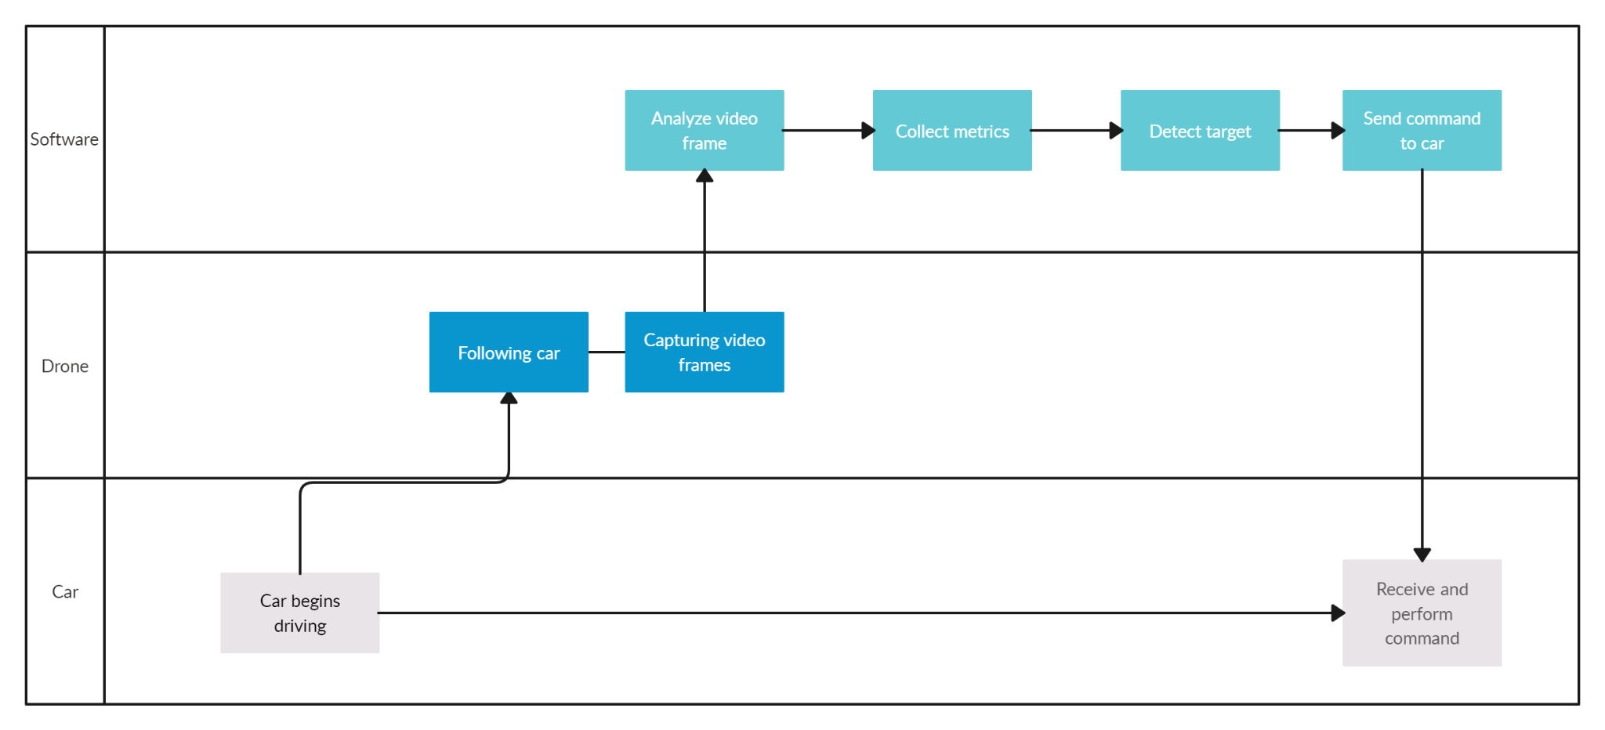
4.1 Project task set
This process model is showing the sequence of events within our project:
Notes:
olivia

Slide 21
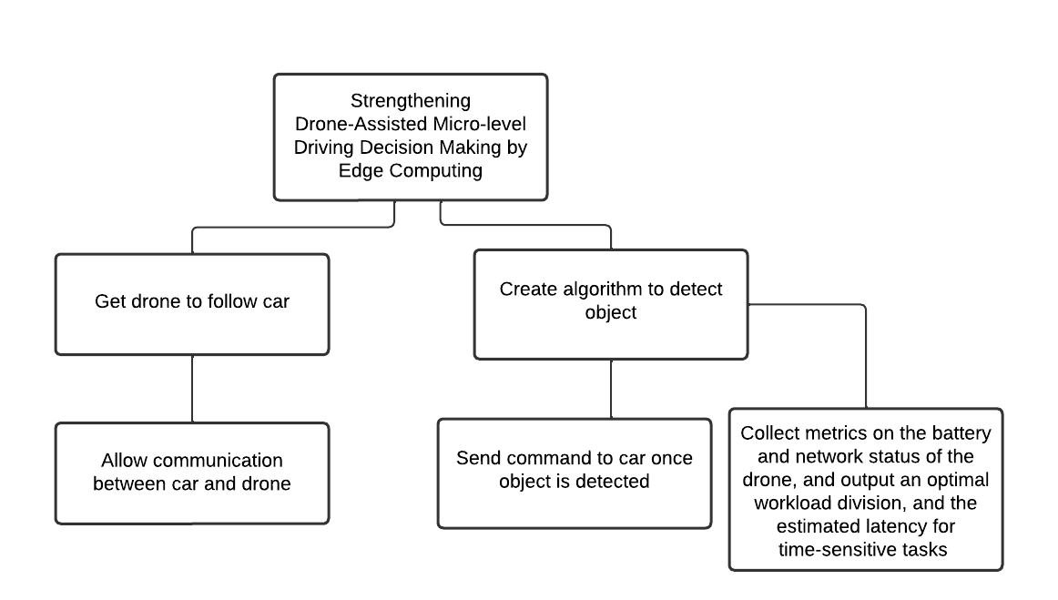
4.2 Functional decomposition
Functional decomposition is used to help breakdown the function of their project into smaller tasks.
Notes:
olivia

Slide 22
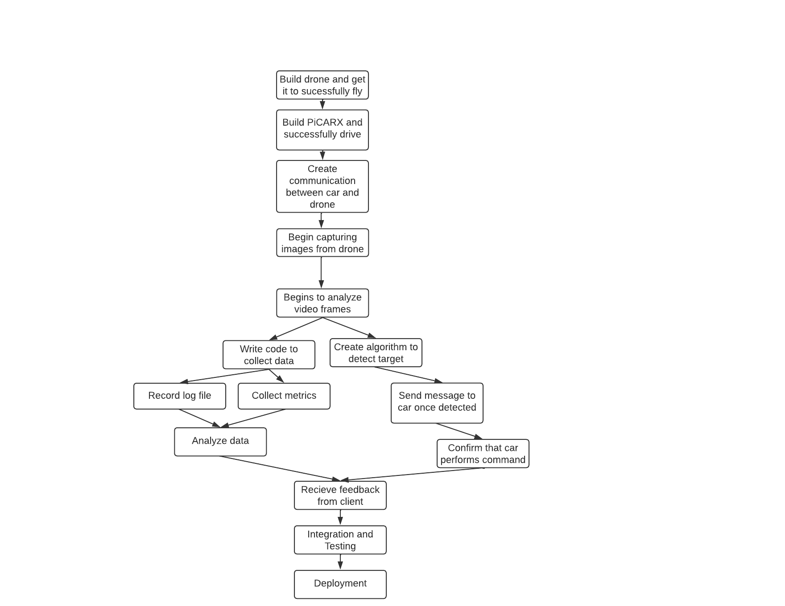
4.3 Task network
This dependencies diagram displays the sequence in which tasks need to be achieved for this project to be completed on time.
Notes:
olivia

Slide 23
Team Structure
Network Architect and Administrator: Ryan Sauer
P2P communication development
Network deployment and maintenance
Data log development
Data analysis
Software Developer: Olivia Pellegrini & Jonathan Schall
Item detection algorithm development
Software quality assurance / testing
Sensor software development
Vehicle Administrator and Developer: Demetrius Johnson
Hardware quality assurance
Vehicle maintenance
Vehicle control development
Shared Responsibilities:
Documentation
System testing
Class reports
Scheduling
Note: Due to small team size and limited availability, team members may help other roles with duties in varying amounts
Notes:
meech

Slide 24
Management Reporting and Communication
Schedule
Jira
Schedule Distribution
Google Drive
Communication
Gmail
Zoom
in person
Team Communication
Google Chat
Version Control
GitHub
Notes:
meech

Slide 25
Quality Assurance and Control
We will maintain quality assurance and control through:
Weekly meetings with the client.
Weekly meetings as a team.
Making sure that we check off items on the product backlog.
Accountability through team members completing their respective tasks.
Staying on schedule so that we have enough time to produce quality products throughout the project lifecycle.
Notes:
meech

Slide 26
Change Management and Control
We will always consult with the client via a meeting before making any major project changes, such as downgrading or upgrading the final product, etc.
We have a project manager role that will serve to keep everyone on track with the respective tasks and make sure that members do not overstep their boundaries and make changes in areas of the project that are not assigned to them.
If changes are made, even if it is in a member's area of responsibility, they will still be documented and communicated to the rest of the team and to the client.
Notes:
meech

Slide 27
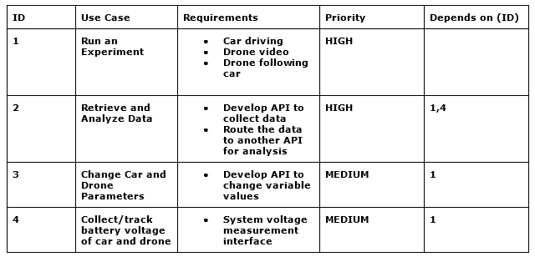
Appendix/References
Bureau of Labor Statistics: https://www.bls.gov/oes/current/oes_stru.htm
Software Engineering: A Practitioner’s Approach: Roger S. Pressman Bruce R. Maxin (2014)(chapter 33.6 and 33.7, 21.1, and 21.2)
Timeline chart: https://docs.google.com/spreadsheets/d/1Np0KL0MUnTC7GoU5v01r7UdblBakfGlUsDKDI06vU_Y/edit?usp=sharing
COCOMO Function Point Estimation Model
http://groups.umd.umich.edu/cis/course.des/cis525/js/f00/gamel/cocomo.html
Traceability Matrix
Notes:
meech

